Slide 1



A PRESENTATION ON design and implementation of a use of natural language processing to develop a system for automatically translating languages
Presented by: Presented to:
Deepak Chaudhary Mr . Sumit Kumar
Arpit Saxena Department of CSE
Amit Garg
(2nd year CSE undergraduate )

Slide 2
layout
Introduction
Background
Conclusions
TimeLine
Methodology
Purposed modification
Resources
Evaluations

Slide 3

INTRODUCTION
The ability to communicate across different languages is essential in a globalized world where businesses, individuals, and organizations must work together across borders and cultures.
However, language barriers can often make communication challenging, leading to misunderstandings and misinterpretations.
In response to this challenge enabling seamless communication between people who speak different languages.
In this project, we will explore the technical aspects of developing a voice translator tool, including speech recognition, translation algorithms, and user interface design.

Slide 4
BACKGROUND
Need to overcome the language barrier of different people across the world.
It will help to learn the different culture of the world as we can communicate with different race.
It is helpful for student who are learning the languages
It helps as a guide if we are travelling.

Slide 5
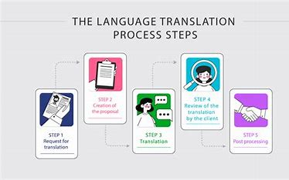
METHODOLOGY
we will explore the technical aspects of developing a voice translator tool
including speech recognition
translation algorithms
user interface design with the help of programming language like java , JavaScript , html, CSS.
Android studio is used for making.
Multiple frameworks provide APIs The TensorFlow + Keres combination is by far the most popular, but competing frameworks, such as Py Torch, Caffe, and Theano, are also widely used

Slide 6
purposed modification
Text input
Voice input
Multiple languages
Seem less experience

Slide 7


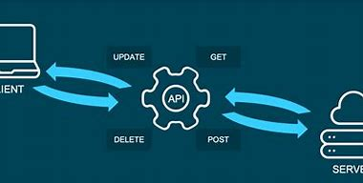
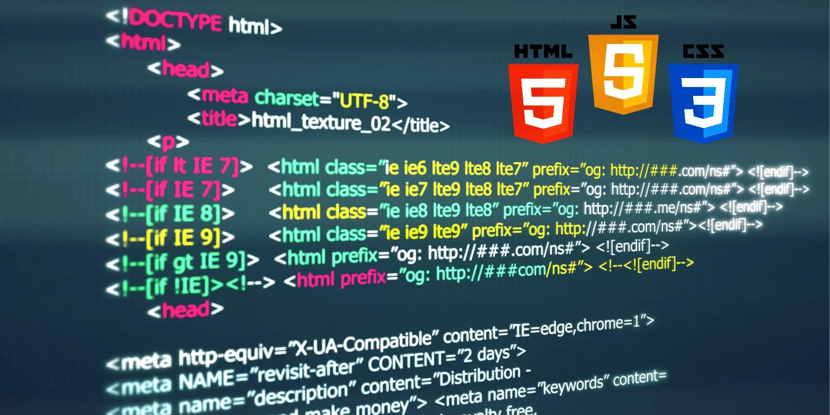

resources

Slide 8
timeline
Project
programming (20 days)
app/website (10 days)
Report file
Resource, Designing
(5 days)

Slide 9
evaluation
Effectiveness: the tool's ability to translate speech in real-time and recognize multiple languages.
Accuracy: the accuracy of the translations generated by the tool. Compare the quality of translations generated by the tool with translations generated by human translators.
Usability: how user-friendly the tool is, considering factors such as the tool's interface design, ease of use, and accessibility. You may also want to gather feedback from users to determine their level of satisfaction with the tool.

Slide 10
Conclusion
In conclusion, the voice translator project aimed to develop a tool that would enable users to communicate in different languages seamlessly.
the voice translator project has demonstrated the power of technology in overcoming language barriers, and its success opens up exciting possibilities for the future of global communication.
The project successfully achieved this goal by creating a voice translation tool that could translate speech in real-time and provide accurate translations.

Slide 11
thank you any queries?

